Slide 1
C Sharp
Structures , Enumeration
& Generics

Slide 2
Topics
struct
Define , access
Mini Project – LMS
Enumeration
Generics
Structure
Methods
Class

Slide 3
struct
Declare Strucure
struct StructName
{
dataType variable;
};
Define Variables
StructName node;
StructName [] nodeList;
Access Structure
node.variable = ….
nodeList[index].variable = ….

Slide 4
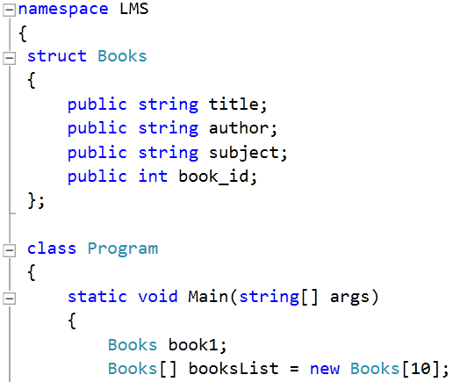
Example - struct

Slide 5
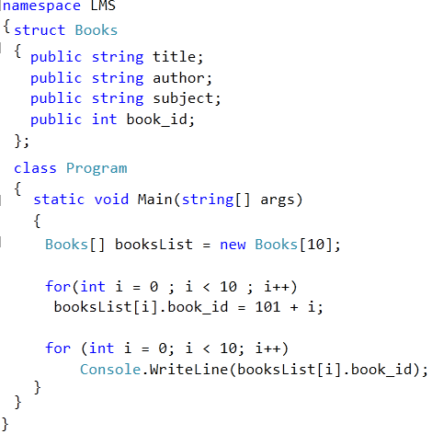
Library Management System

Slide 6
Mini Project # 3
Library Management System
Write a Complete C Sharp application for LMS
Maintain Record of 5 to 10 Books
On Demand
Add New Books in Record (up to 10 books)
Issue Books to Teachers and Students
Update Record when any book returned.
Display records of all books and their status in tabular form.

Slide 7
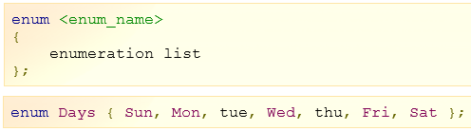
Enumeration
An enumeration is a set of named integer constants. An enumerated type is declared using the enum keyword

Slide 8
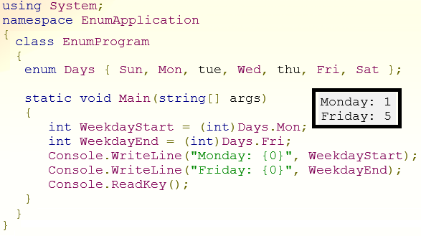
Enumeration

Slide 9
C Sharp - Generics
Generics
allow you to delay the specification of the data type of programming elements in a class or a method until it is actually used in the program.
In other words, generics allow you to write a class or method that can work with any data type
Generic
Class / Structure
Methods
Delegates etc

Slide 10
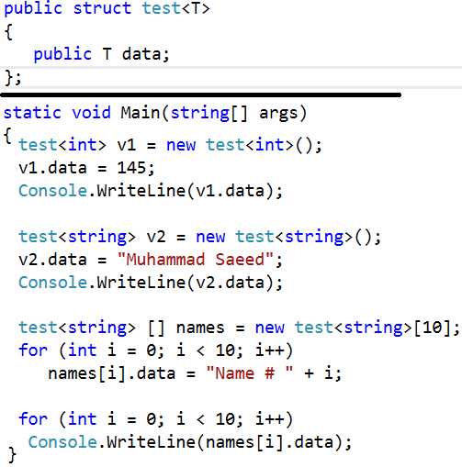
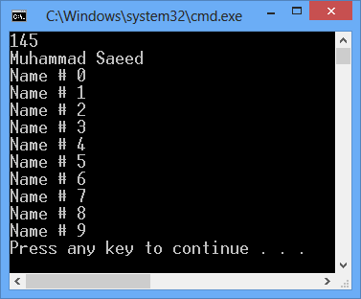
Generic - Structure

Slide 11
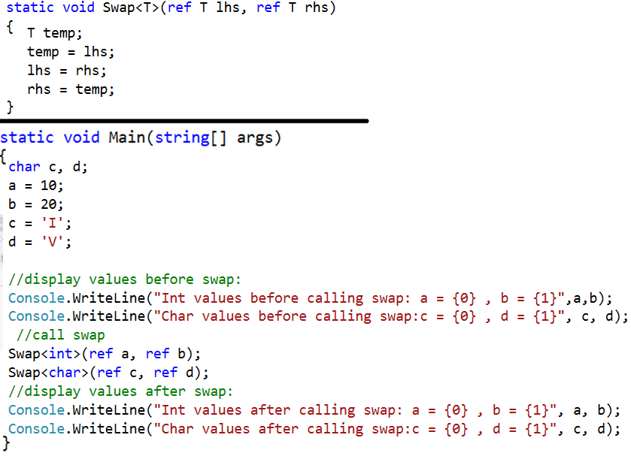
Generic - Methods

Slide 12
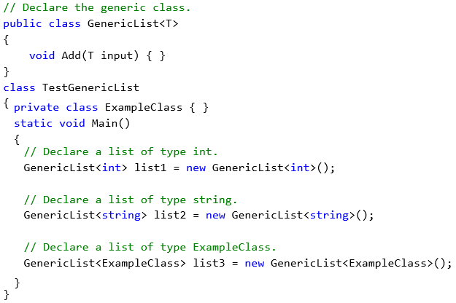
Generic - Class

